Slide 1

SOA Performance Testing Challenges
First Presented for:
Software Test & Performance Conference
November 2007, Boston, MA
Scott Barber
Chief Technologist
PerfTestPlus, Inc.

Slide 2
Who Am I?
Chief Technologist, PerfTestPlus, Inc.
Co-Founder, Workshop On Performance & Reliability
Executive Director, Association of Software Testing
Author of over 50 academic & practitioner papers on performance testing
International Keynote Speaker and Trainer
To some, I'm an “expert” performance test consultant
Others call me the “Perf Guy”
In Short...

Slide 3
Who Am I?
My name is Scott Barber and I'm a
Test-aholic

Slide 4
Agenda
Overview
Evolution of Software Architecture
The Concept of SOA
SOA Testing Challenges (Other than performance)
SOA Performance Testing Challenges
Common SOA Testing Challenges
Summary

Slide 5
Overview
The technologies, standards, applications and management of Services Oriented Architectures (SOA) are still in a significant state of flux.
Unfortunately, that doesn't stop folks from using it,
or keep us from having to test it.

Slide 6
Overview
SOA is based on a variety of concepts that we, as an industry, have seen and tested before...
some for nearly a decade.
Luckily, this means that, as an industry, we have a lot of tried and true testing techniques at our disposal to apply to SOA projects.

Slide 7
Overview
Testing SOA applications is more complex than the majority of applications many of us have become used to testing recently.
The up-side is that this complexity is likely to force us to test SOA applications in the ways we should have been testing applications all along.

Slide 8
Evolution of Software Architecture
Stand Alone
Client-Server
Distributed “n-tier”
Web Services
Service Oriented

Slide 9

Stand Alone Architecture
Tightly coupled collections of data and function residing on a single machine.
Reuse, redesign, and replacement of component parts can be very difficult.

Slide 10
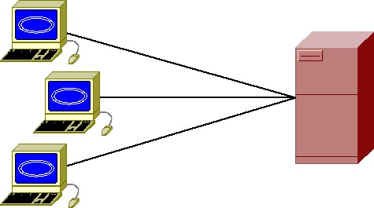
Client-Server Architecture
Similar to Stand Alone:
  Tightly coupled collections of data and functions reside on a single machine (server).
  Reuse, redesign, and replacement of component parts can be very difficult.
Unique in that the multiple users access the application from remote machines (clients).

Slide 11
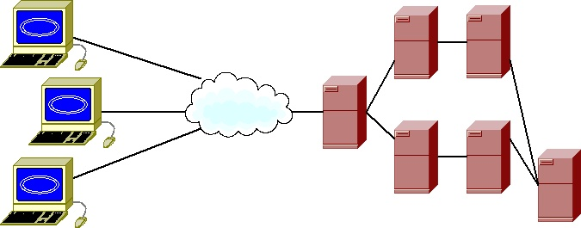
Distributed Architecture
Loosely or tightly coupled collections of data and function residing on multiple machines.
Reuse, redesign, and replacement of component parts may or may not be very difficult.
Typically serves multiple remote users.

Slide 12
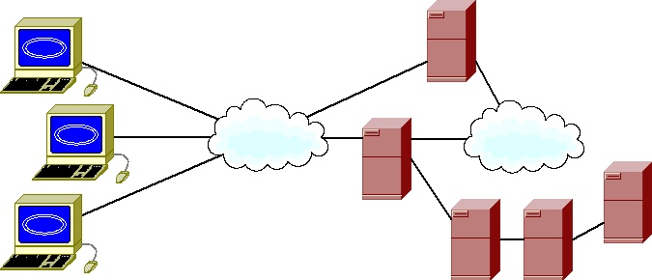
Web Services Architecture
Loosely or tightly coupled collections of data and function residing on multiple machines.
One or more collection of data and/or function built and hosted externally.
Reuse, redesign, and replacement of component parts may or may not be very difficult.
Typically serves multiple remote users.

Slide 13
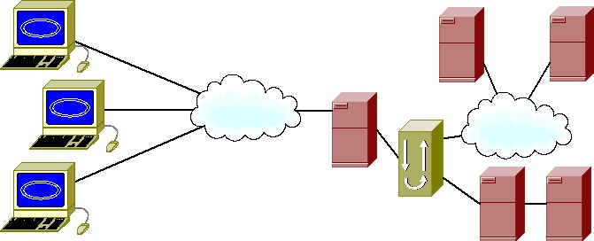
Service Oriented Architecture
Loosely coupled collections of data and function residing on multiple internal or external machines.
Often, collections communicate through a single interface.
Reuse, redesign, and replacement of component parts should not be very difficult.
Typically serves multiple remote users.

Slide 14
The Concept of SOA (General)
Service Oriented Architecture (SOA) is an approach to implement business systems across a loosely coupled set of technologies.

Slide 15

The Concept of SOA (View 1)
SOA is “a way of designing and implementing enterprise applications that deals with the intercommunication of loosely coupled, coarse grained (business level), reusable artifacts (services) that are accessed through well-defined, platform independent, interface contracts."
- Steve Wilkes

Slide 16

The Concept of SOA (View 2)
“I've heard people say the nice thing about SOA is that it separates data from process, that it combines data and process, that it uses web standards, that it's independent of web standards, that it's asynchronous, that it's synchronous, that the synchronicity doesn't matter...
... I was on the SOA panel. I played it for laughs by asking if anyone else understood what on earth SOA was. Afterwards someone made the comment that this ambiguity was also something that happened with Object Orientation. There's some truth in that, there were (and are) some divergent views on what OO means. But there's far less Object Ambiguity than the there is Service Oriented Ambiguity…”
- Martin Fowler

Slide 17

SOA Application Design
This part, everyone seems to agree on.
Business Level
Function
Function A
Function B
Function C
Component
(Service)
Function D
Function E
User Interface
Application A

Slide 18
The SOA Concept
In fact, these services can from many sources and be distributed over heterogeneous environments.
Developed
3rd Party
Shared
Purchased
Purchased
Developed

Slide 19
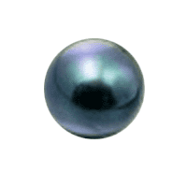


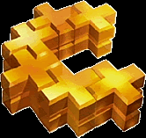

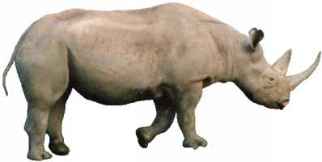

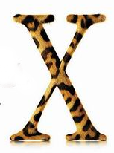





Innovations
The ambiguity Martin Fowler jokes about is the myriad of available choices in hardware, software, and process technologies.

Slide 20

Service Oriented Architecture
Testing Challenges

Slide 21
SOA Testing Challenges
Since SOA applications are composed of loosely coupled, business-level services, distributed over a network, we must test the application...
  end-to-end,
  service-by-service
  and interface-by-interface.

Slide 22
SOA Testing Challenges
We need to trust SOA services in the following areas, but we may not control the testing.
Functionality
  API (Application Programming Interface)
  Interoperability/Integration
Publish, Find and Bind
Security
Performance

Slide 23
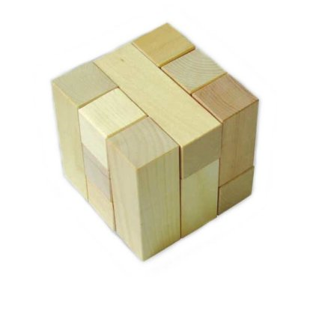
Functionality Testing Challenges
The overall functionality of SOA applications should be easier to test.
That is only if we, or someone we
trust, thoroughly test the application’s
components (services) before
we assemble them to create
the application.
Starting with lower-defect components typically means a smoother testing process BUT …

Slide 24
Functionality Testing Challenges
SOA applications tend to have more:
  APIs (one for each service)
  Communication paths between those services
There is now an increased level of integration and interoperability testing that must be performed.
Who is responsible for this testing...
  The service provider? The service requester? Both?
  Someone else?
How do we establish trust?

Slide 25
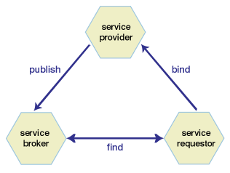
Publish, Find and Bind Testing Challenges
Service providers must “advertise” their existence to brokers (automated catalogues).
Service requesters (SOA applications) must find providers and connect (bind) to them to use their services.
Service brokers must accept
registrations and then provide
information through search
functions.

Slide 26
Publish, Find and Bind Testing Challenges
You may not have tested anything like this before... unless you've tested 3rd party credit card processing for a web application.
Are the services your organization is providing able to properly register themselves?
Can your SOA application find and properly bind with services?
Who is responsible for this testing...
  The service provider? The service requester? Both?
  Someone else?
How do we establish trust?

Slide 27
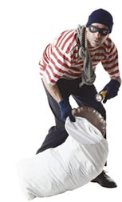
Security Testing Challenges
An SOA application is a collection of independent services, collaborating to provide valuable functionality.
“Valuable” often suggests the need
for security, for the authentication
of users before access.
Consider an application in which each service requires a different authentication approach and enforces different security policies – it’s a design, development, and testing nightmare.

Slide 28
Security Testing Challenges
Your organization needs a centralized SOA security management approach.
Various strategies include:
  Ignore the problem.
  Hide within a private network.
  Whip up a home-brewed solution.
  Buy this functionality from an experienced vendor.
Who is responsible for this testing...
  The service provider? The service requester? Both?
  Someone else?
How do we establish trust?

Slide 29
Performance Testing Challenges
All this loosely-coupled, platform-independent stuff is not free.
Major performance problems are often due to:
  Layer upon layer; abstraction upon abstraction
  Small services with large overhead
  Large services that are under supported by hardware
  Services distributed across a network with its associated latency
One could also say...
“Performance is not synergistic.”

Slide 30
Performance Testing Challenges
The application will need to be performance tested...
  End-to-end, from the user's perspective (requester)
  At the unit level during development (provider)
  At the service level (likely both requester and provider)
  To validate each interface (likely both requester and provider)
  To ensure correct functionality under load

Slide 31
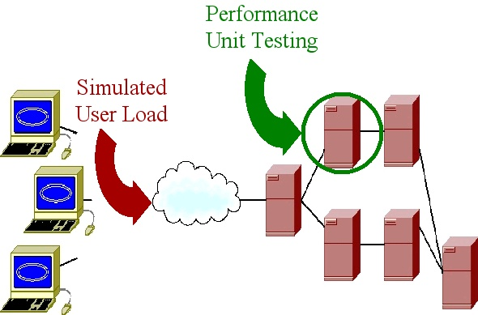
Performance Testing Challenges
What we’ve become accustomed to.

Slide 32
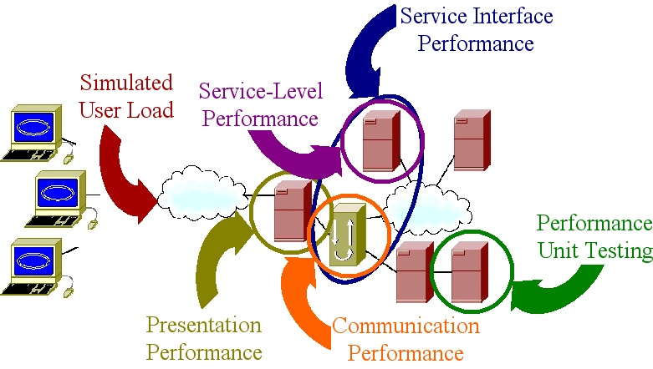
Performance Testing Challenges
What we should have been doing in the first place.

Slide 33


Common SOA Testing Challenges
What is your degree of trust in… ?
Functionality
APIs
Integration/Interoperability
Publish, Find, and Bind
Security Or are you?
Performance

Slide 34
SOA Testing Challenges Overall
Whose responsibility is it to test services?
  The provider?
  The requester?
  Both?
  Someone else?
How well did your vendor test?
  How do you know?
How do we establish trust in a service?
How do we demonstrate that our SOA application is worthy of the trust of our users?

Slide 35
Summary
SOA adds complexity, but very little that is really “new”.
Trust between providers and requesters is key.
SOA ought to force us to test the way we probably should be testing anyway.
Performance testing SOA forces us to think about what is in and out of our control.
Performance testing SOA requires an ability to decompose and recompose the system by tier.
Specialized tools may be helpful, but not unless we are analyzing the problem adequately.

Slide 36

Questions

Slide 37
Contact Info
Scott Barber
Chief Technology Officer
PerfTestPlus, Inc
E-mail:
sbarber@perftestplus.com
Web Site:
www.PerfTestPlus.com

